Slide 1
Community Solar Organizing Rally
Chat Activity - Pancakes vs. Waffles
We are going to play pancakes vs. waffles in the chat! Join in whenever you’re ready.
The rules are easy:
You’ll need to pick between pancakes and waffles
Whichever one has the fewest votes is gone from the world forever
The remaining thing will now be compared to something new
And so on and so forth
Example:
“Pancakes vs. Waffles?”
“Waffles!”
“Waffles vs. Cars?”
“Cars.”
Cars vs. Computers?”
“Computers.”

Slide 2
Community Solar Organizing Rally
Erin Doran, Morgan Hallberg, Nathan Hatcher, Robert Hazen, Zoe Ketola, Elise Matz, Ava Miller, Alexis Pascaris, Cheyenne Scott, Christian Sheja, Tom Vermeesch

Slide 3
Rally Goals:
Understand community solar
Know current policy
Motivate change
Provide resources
Connect people

Slide 4
Tonight’s Agenda
Motivational Story
Community Solar Description
Need for Policy Change
Real life stories/ examples
Resources
Break out rooms for questions

Slide 5
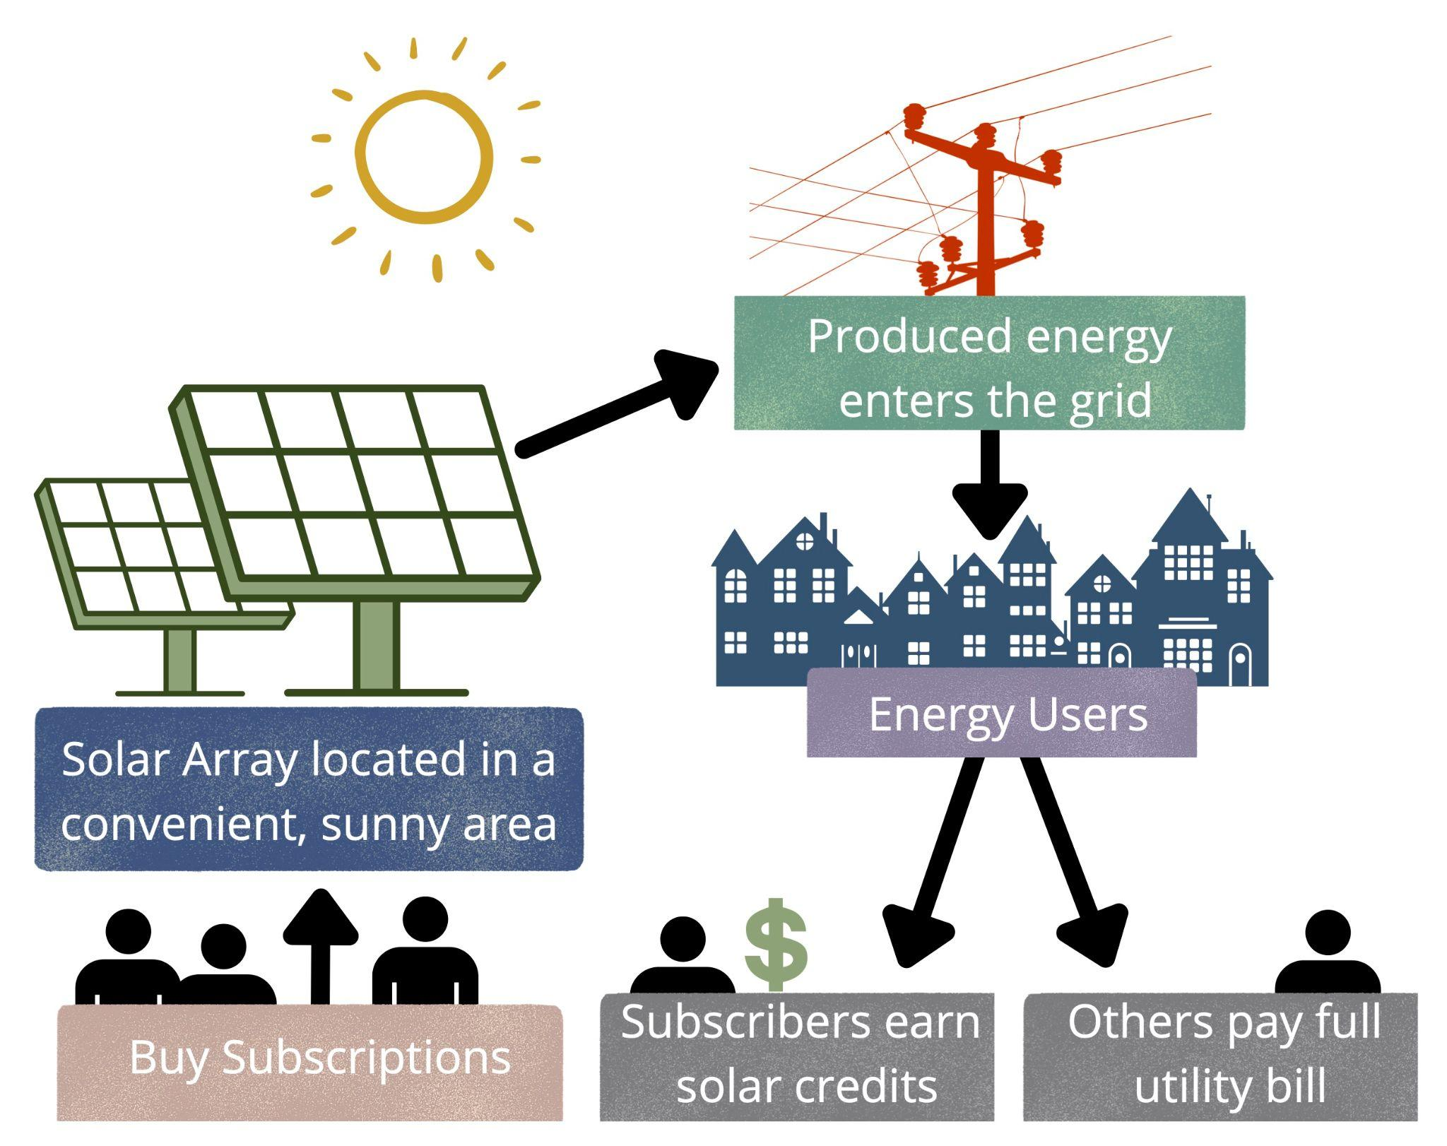
What is Community Solar?
Community Solar Diagram by Morgan Hallberg

Slide 6
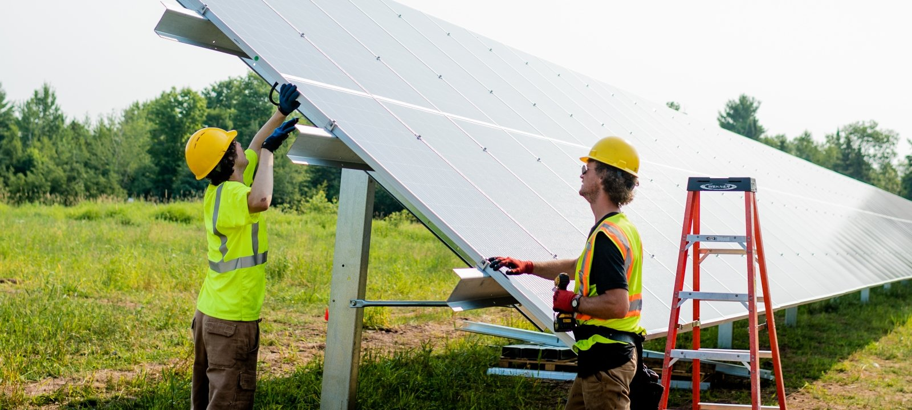
What are the benefits of community solar?
Allows people who may not be able to install solar panels to still benefit
Allows more freedom of choice and energy independence
Can be strategically located in places with lots of sunlight
Helps to create a stronger more resilient grid
More steps towards green energy
https://www.mtu.edu/news/2020/03/solar-for-the-people.html

Slide 7
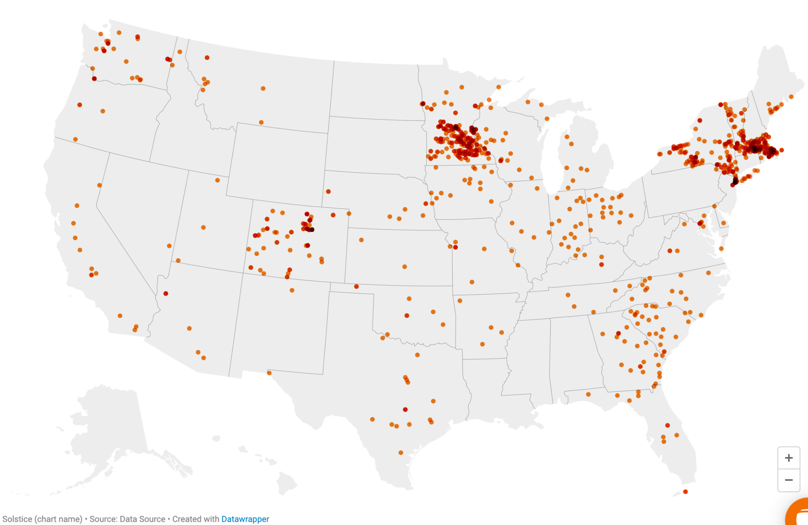
Why do you think there are fewer community solar projects in Michigan?
Poll Time!

Slide 8
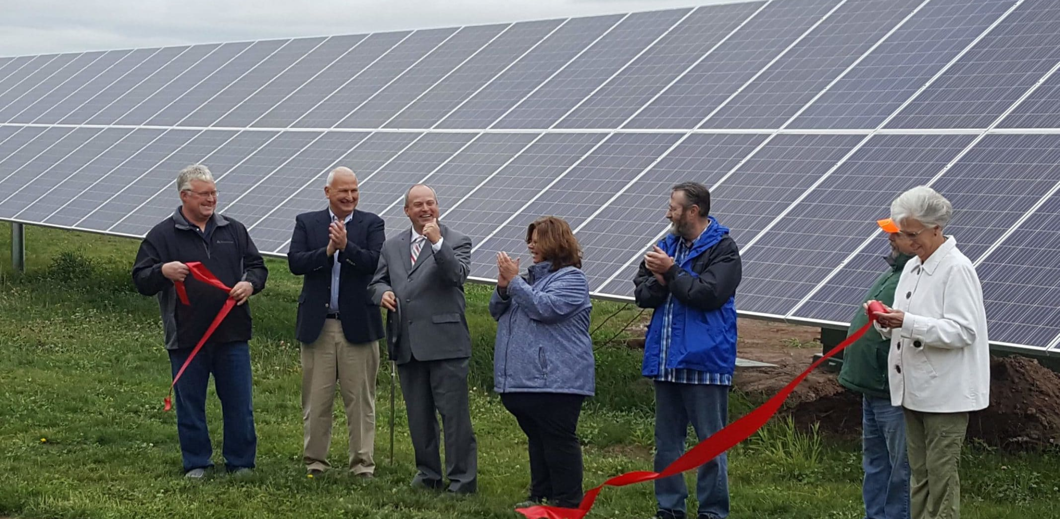
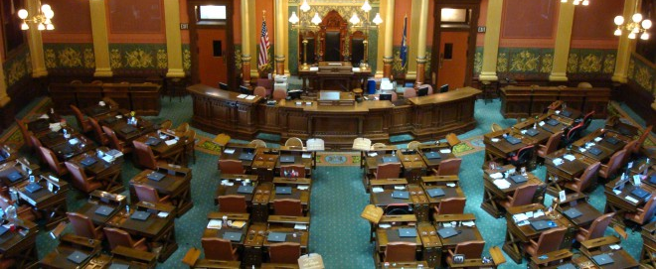
Why now?
Utilities heavily restrict access
Major outages throughout Michigan
Bipartisan House Bills 4715 & 4716
Large policy window to enact change
Currently no plans for Energy Policy reform

Slide 9
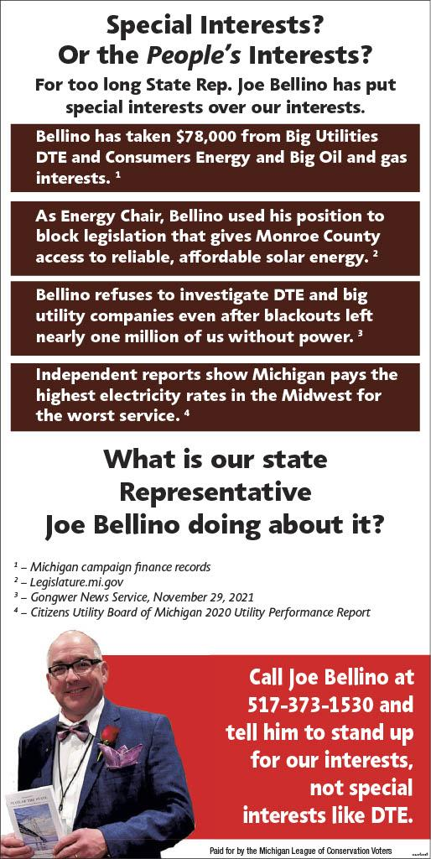
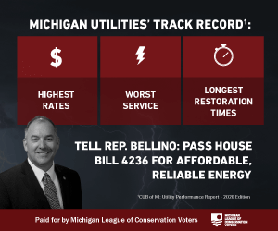
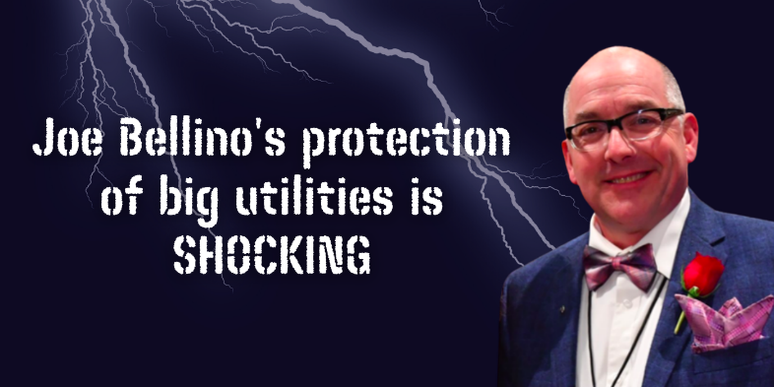
Bill Update
Bellino reluctant to call a vote
Wants utilities to compromise
Utilities stalling
Rigorous ad campaigns pressuring Bellino
Possible Jan. meeting with utilities and MI Community Solar Alliance?
Waves of pressure to wear Bellino down
Ad from: MICEF

Slide 10
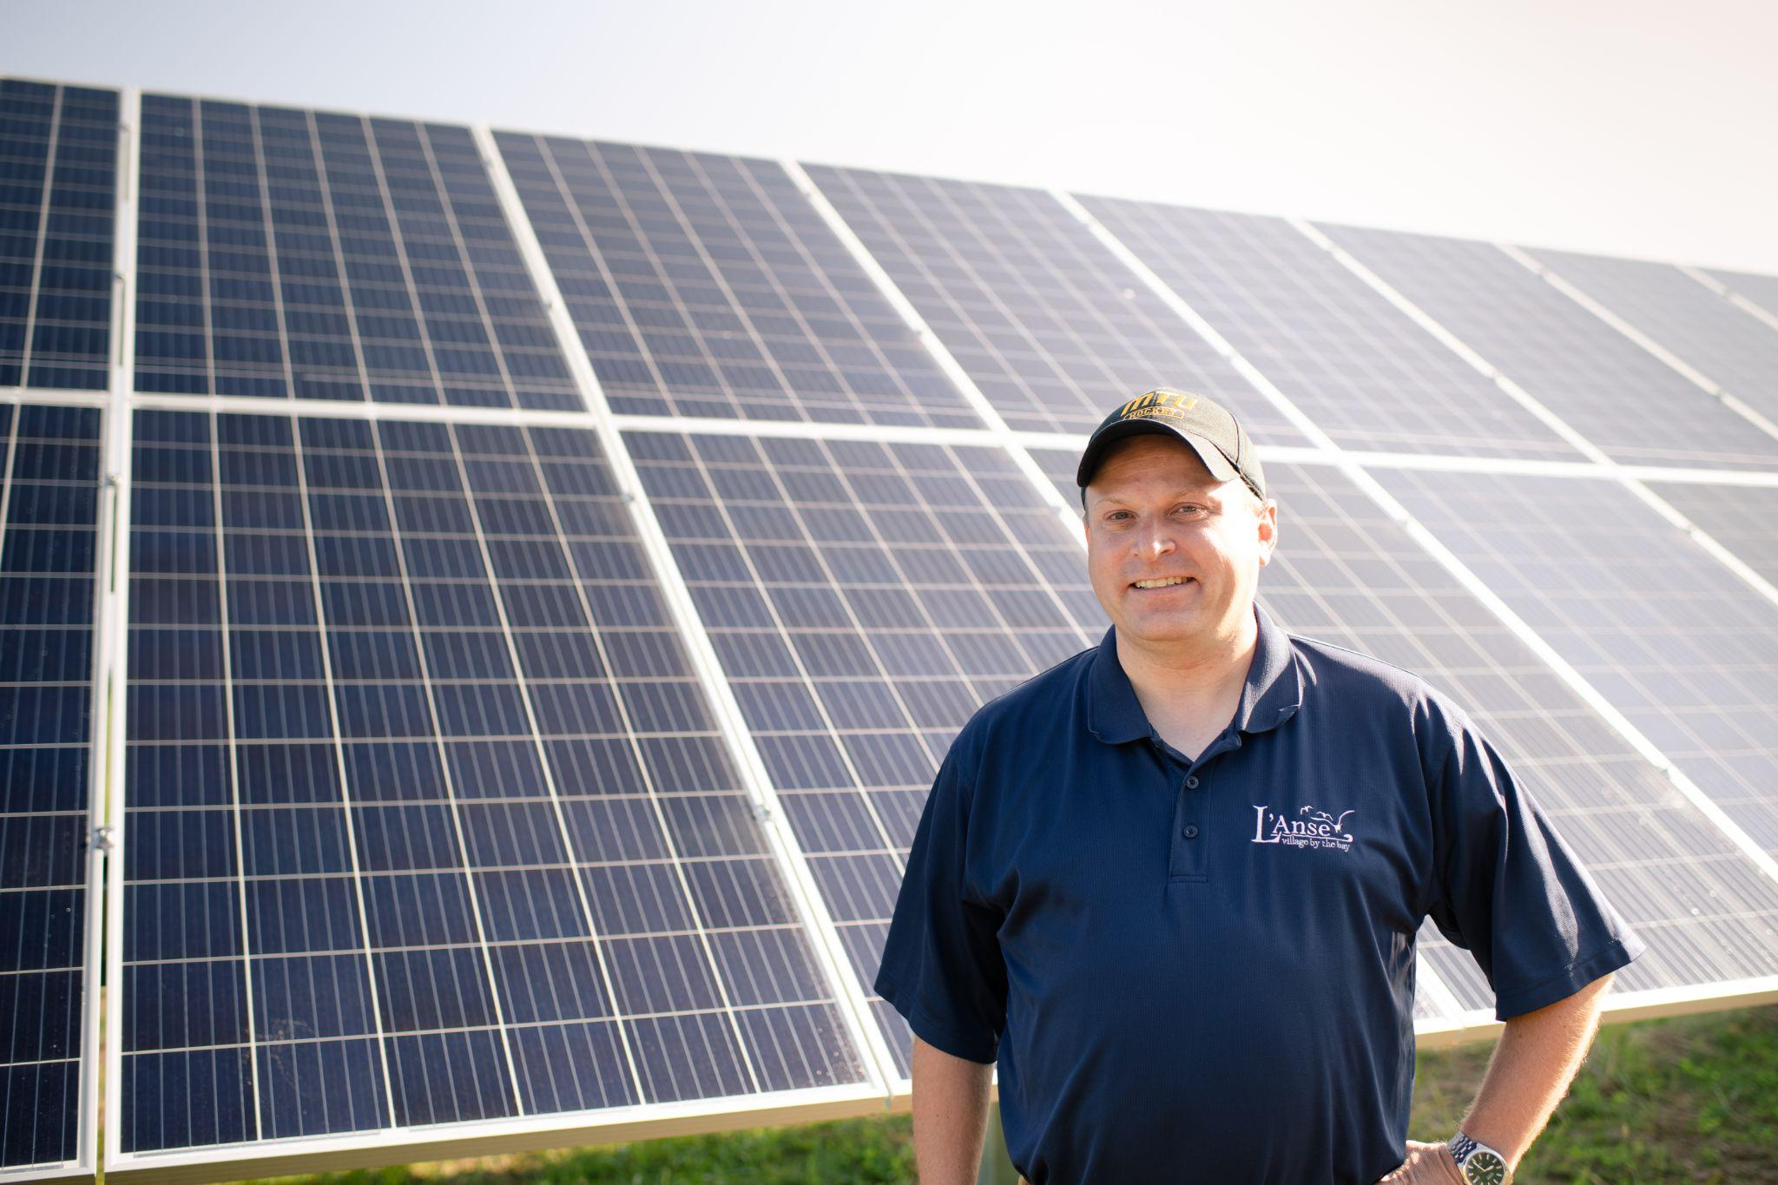
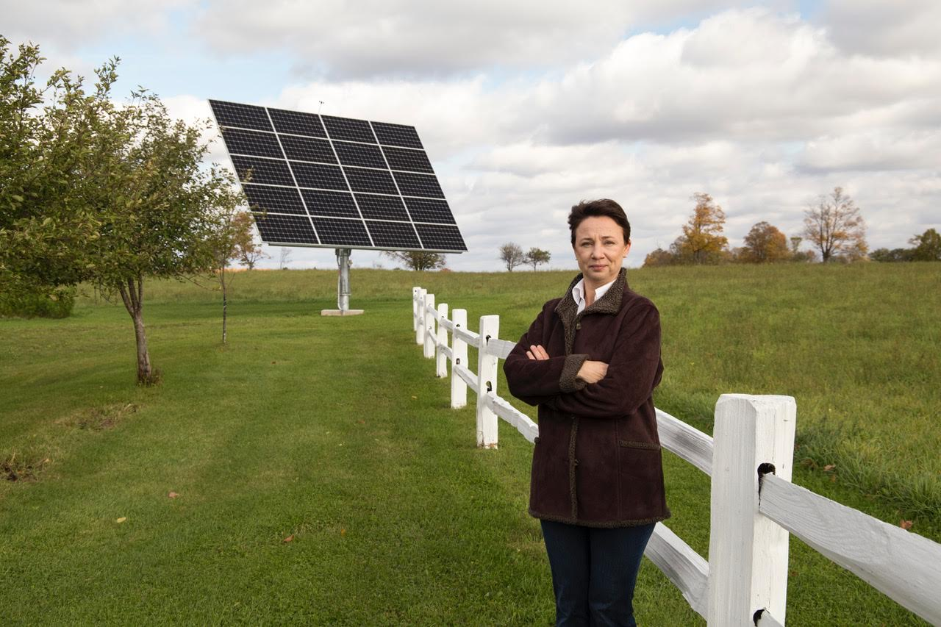
Stories: Why do we need enabling policy?
Bob LaFave & the Success of Community Solar in L’Anse, MI
Renee Richer & Barriers to Community Solar in Escanaba, MI
“This is a local program, designed by local folks that live here and work here, that has local benefits for the community. If it can be done in our little town here, I think it can be done just about anywhere, and I really do feel that way.”
-Bob LaFave
Residents are not against solar.
They are against development that will not
serve their communities.

Slide 11
Call to Action
WRITE YOUR REP!
Invite others to participate!
Strong voice together!

Slide 12
Our Campaign
And how you can help!

Slide 13
Supporting Toolkit
Letter templates
Social media / poster graphic
Educational document with more info
Personal stories

Slide 14
How to convince a representative to support the bills

Slide 15
Power Mapping
It is important to understand what issues the representatives prioritize in their districts
This gives you talking points more than anything

Slide 16
Letter to Rep. guide
Dear Representative Mari Manoogian:
I’m writing today to ask you to support House Bills 4715 and 4716, important legislation which modernizes state law to allow access to community solar projects here in Michigan.
It is no secret that Michigan’s infrastructure is in serious disrepair. While our roads and bridges are quite literally crumbling, the aging infrastructure which helps Michigan residents power their homes is also in need of repair. As our power grid modernizes, Michiganders could have a say in how the reconstruction would benefit their local communities most. This begins with the passing of these bills which mandate that the utility companies work with communities to design renewable energy programs customly designed for their area. If you are committed to finding a solution that funds projects to fix our electrical grid in ways that work for Michigan families, then community solar programs should be one of your top priorities. These modern infrastructure updates, in addition to regional transit and electric vehicle charging infrastructure, will foster economic development and make Michigan a destination state.
Currently, the utility companies in our state do not have to allow input for how we as residents receive our power. They have functioned how they historically have, which is developing as they see fit often without considering factors that only the residents of a community could be aware of. They develop to benefit their shareholders first, while these bills prioritize the concerns of residents and give back the greatest return of sale to them.
The bills enable our communities to proliferate solar energy projects by working with communities. Existing community solar projects have proven successful in Michigan and around the country. They can improve the grid by making the source of energy more local and resilient. The ability for low and middle income households to more equitably become shareholders in power production allows them to reinvest money otherwise set aside for high utility bills to expenditures like healthcare. Current energy policy in Michigan restricts our options, limiting access to community solar and corner the free market.
Thank you for supporting bills like 4701 and 4161, which aim to help families afford basic healthcare supplies. These bills which I am passionate about today also aim to help Michigan residents provide another basic need for their families, electricity.
We are privileged to live in such a great state of opportunity, help expand the opportunities for local communities to have a voice in how they empower their residents. The time to act is now. Please do what is right for Michigan families and vote in favor of HB 4715 and 4716.
Thank you for your time,
Respectfully,
(Your Name)
(Address - to prove you are their constituent)

Slide 17
Letter to Rep. guide
Dear Representative Mari Manoogian:
I’m writing today to ask you to support House Bills 4715 and 4716, important legislation which modernizes state law to allow access to community solar projects here in Michigan.
It is no secret that Michigan’s infrastructure is in serious disrepair. While our roads and bridges are quite literally crumbling, the aging infrastructure which helps Michigan residents power their homes is also in need of repair. As our power grid modernizes, Michiganders could have a say in how the reconstruction would benefit their local communities most. This begins with the passing of these bills which mandate that the utility companies work with communities to design renewable energy programs customly designed for their area. If you are committed to finding a solution that funds projects to fix our electrical grid in ways that work for Michigan families, then community solar programs should be one of your top priorities. These modern infrastructure updates, in addition to regional transit and electric vehicle charging infrastructure, will foster economic development and make Michigan a destination state.
Currently, the utility companies in our state do not have to allow input for how we as residents receive our power. They have functioned how they historically have, which is developing as they see fit often without considering factors that only the residents of a community could be aware of. They develop to benefit their shareholders first, while these bills prioritize the concerns of residents and give back the greatest return of sale to them.
The bills enable our communities to proliferate solar energy projects by working with communities. Existing community solar projects have proven successful in Michigan and around the country. They can improve the grid by making the source of energy more local and resilient. The ability for low and middle income households to more equitably become shareholders in power production allows them to reinvest money otherwise set aside for high utility bills to expenditures like healthcare. Current energy policy in Michigan restricts our options, limiting access to community solar and corner the free market.
Thank you for supporting bills like 4701 and 4161, which aim to help families afford basic healthcare supplies. These bills which I am passionate about today also aim to help Michigan residents provide another basic need for their families, electricity.
We are privileged to live in such a great state of opportunity, help expand the opportunities for local communities to have a voice in how they empower their residents. The time to act is now. Please do what is right for Michigan families and vote in favor of HB 4715 and 4716.
Thank you for your time,
Respectfully,
(Your Name)
(Address - to prove you are their constituent)

Slide 18
Letter to Rep. guide
Dear Representative Mari Manoogian:
I’m writing today to ask you to support House Bills 4715 and 4716, important legislation which modernizes state law to allow access to community solar projects here in Michigan.
It is no secret that Michigan’s infrastructure is in serious disrepair. While our roads and bridges are quite literally crumbling, the aging infrastructure which helps Michigan residents power their homes is also in need of repair. As our power grid modernizes, Michiganders could have a say in how the reconstruction would benefit their local communities most. This begins with the passing of these bills which mandate that the utility companies work with communities to design renewable energy programs customly designed for their area. If you are committed to finding a solution that funds projects to fix our electrical grid in ways that work for Michigan families, then community solar programs should be one of your top priorities. These modern infrastructure updates, in addition to regional transit and electric vehicle charging infrastructure, will foster economic development and make Michigan a destination state.
Currently, the utility companies in our state do not have to allow input for how we as residents receive our power. They have functioned how they historically have, which is developing as they see fit often without considering factors that only the residents of a community could be aware of. They develop to benefit their shareholders first, while these bills prioritize the concerns of residents and give back the greatest return of sale to them.
The bills enable our communities to proliferate solar energy projects by working with communities. Existing community solar projects have proven successful in Michigan and around the country. They can improve the grid by making the source of energy more local and resilient. The ability for low and middle income households to more equitably become shareholders in power production allows them to reinvest money otherwise set aside for high utility bills to expenditures like healthcare. Current energy policy in Michigan restricts our options, limiting access to community solar and corner the free market.
Thank you for supporting bills like 4701 and 4161, which aim to help families afford basic healthcare supplies. These bills which I am passionate about today also aim to help Michigan residents provide another basic need for their families, electricity.
We are privileged to live in such a great state of opportunity, help expand the opportunities for local communities to have a voice in how they empower their residents. The time to act is now. Please do what is right for Michigan families and vote in favor of HB 4715 and 4716.
Thank you for your time,
Respectfully,
(Your Name)
(Address - to prove you are their constituent)

Slide 19
Letter to Rep. guide
Dear Representative Mari Manoogian:
I’m writing today to ask you to support House Bills 4715 and 4716, important legislation which modernizes state law to allow access to community solar projects here in Michigan.
It is no secret that Michigan’s infrastructure is in serious disrepair. While our roads and bridges are quite literally crumbling, the aging infrastructure which helps Michigan residents power their homes is also in need of repair. As our power grid modernizes, Michiganders could have a say in how the reconstruction would benefit their local communities most. This begins with the passing of these bills which mandate that the utility companies work with communities to design renewable energy programs customly designed for their area. If you are committed to finding a solution that funds projects to fix our electrical grid in ways that work for Michigan families, then community solar programs should be one of your top priorities. These modern infrastructure updates, in addition to regional transit and electric vehicle charging infrastructure, will foster economic development and make Michigan a destination state.
Currently, the utility companies in our state do not have to allow input for how we as residents receive our power. They have functioned how they historically have, which is developing as they see fit often without considering factors that only the residents of a community could be aware of. They develop to benefit their shareholders first, while these bills prioritize the concerns of residents and give back the greatest return of sale to them.
The bills enable our communities to proliferate solar energy projects by working with communities. Existing community solar projects have proven successful in Michigan and around the country. They can improve the grid by making the source of energy more local and resilient. The ability for low and middle income households to more equitably become shareholders in power production allows them to reinvest money otherwise set aside for high utility bills to expenditures like healthcare. Current energy policy in Michigan restricts our options, limiting access to community solar and corner the free market.
We are privileged to live in such a great state of opportunity, help expand the opportunities for local communities to have a voice in how they empower their residents. The time to act is now. Please do what is right for Michigan families and vote in favor of HB 4715 and 4716.
Thank you for your time,
Respectfully,
(Your Name)
(Address - to prove you are their constituent)

Slide 20
Breakout Rooms
Learn more about Community Solar
Learn more about the L’Anse Project
Letter Writing workshop

Slide 21
Feedback
Pros
Cons
Takeaways

